Slide 1

Natural Language Processing DLO 8012
Subject In-charge
Ms Vincy Joseph
Assistant Professor
email: vincyjoseph@sfit.ac.in

Slide 2
Module IV
Lecture 23 Semantic Analysis

Slide 3
Lexical Semantics
Lexical Semantics is the study of word meaning.
Lexeme is a pair of a particular form (orthographic or phonological) with its meaning
Lexicon is a ﬁnite list of lexemes.
A lexeme is represented by a lemma.
A lemma or citation form is the grammatical form that is used to represent a lexeme.
Carpets → lemma : carpet
sing, sang, sung → lemma : sing.

Slide 4
Lexical Semantics
The speciﬁc forms sung or sing are called wordforms.
The process of mapping from a wordform to a lemma is called lemmatization.
Lemmatization is not always deterministic, since it may depend on the context.
E.g. the wordform found can map to the lemma ﬁnd (meaning ‘to locate’) or the lemma found (‘to create an institution’).

Slide 5
Lexical Semantics
Lemmas are Part-of-Speech speciﬁc; thus the wordform tables has two possible lemmas, the noun table and the verb table.
One way to do lemmatization is via the morphological parsing algorithms.
But a lemma is not necessarily the same as the stem from the morphological parse.
E.g. celebrations →
stem : celebrate ; lemma : celebration.

Slide 6
Word Senses
The meaning of a lemma can vary enormously given the context.
Consider two uses of the lemma bank, meaning something like ‘ﬁnancial institution’ and ‘sloping mound’, respectively:
E.g. Instead, a bank can hold the investments in a custodial account in the client’s name.
But as agriculture burgeons on the east bank, the river will shrink even more.

Slide 7
Homonymy
A sense (or word sense) is a discrete representation of one aspect of the meaning of a word.
We will represent each sense by placing a superscript on the orthographic form of the lemma as in bank¹ and bank².
The two senses are homonyms, and the relation between the senses is one of homonymy.

Slide 8
Homonymy
Sometimes,there is some semantic connection between the senses of a word.
Consider the example: blood bank.
It has some sort of relation to bank¹.
Both are repositories for entities that can be deposited.

Slide 9
Polysemy
When two senses are related semantically, we call the relationship between them polysemy rather than homonymy.
In Polysemy, the semantic relation between the senses is systematic and structured.
E.g. The bank is in the corner of Church.

Slide 10
Polysemy
This sense means something like ‘the building belonging to a ﬁnancial institution’.
Thus there is a systematic relationship between senses that we might represent as
BUILDING↔ORGANIZATION

Slide 11
Metonymy
This particular subtype of polysemy.
Metonymy is the use of one aspect of a concept or entity to refer to other aspects of the entity, or to the entity itself.
E.g. Animal (The chicken was domesticated in Asia) ↔Meat (The chicken was overcooked)
It is very difﬁcult to decide how many senses a word has.

Slide 12
Zeugma
One practical technique for determining if two senses are distinct is to conjoin two uses of a word in a single sentence.
This kind of conjunction is called zeugma.
E.g.
Which of those ﬂights serve breakfast?
Does Midwest Express serve Philadelphia?
?Does Midwest Express serve breakfast and Philadelphia?

Slide 13
Zeugma
The oddness of the invented third example (a case of zeugma) indicates there is no sensible way to make a single sense of serve work for both breakfast and Philadelphia.
We can use this as evidence that serve has two different senses in this case.

Slide 14
Lec 24

Slide 15
Homophones
A special case of multiple senses that causes problems for speech recognition and spelling correction is homophones.
Homophones are senses that are linked to lemmas with the same pronunciation but different spellings,such as wood/would or to/two/too.

Slide 16
Homographs
This problem is related to homophones in speech synthesis.
Homographs are distinct senses linked to lemmas with the same orthographic form but different pronunciations:
E.g.
She let him lead her into the center of the room.
He lead the people into the room.
E.g. minute, tear

Slide 17
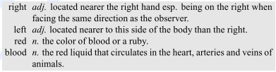
How can we deﬁne the meaning of a word sense?
Can we just look in a dictionary?

Slide 18
How can we deﬁne meaning of a word sense?
One approach to deﬁne a word sense is to make use of a similar approach to the dictionary deﬁnitions; deﬁning a sense via its relationship with other senses.
The second computational approach to meaning representation is to create a small ﬁnite set of semantic primitives, atomic units of meaning, and then create each sense deﬁnition out of these primitives.

Slide 19
Relations between Senses

Slide 20
Synonymy and Antonymy
Synonym : When the meaning of two senses of two different words (lemmas) are identical or nearly identical
Synonyms include such pairs as:
couch/sofa
vomit/throw up
car/automobile

Slide 21
Synonymy and Antonymy
Formal deﬁnition : Two words are synonymous if they are substitutable one for the other in any sentence without changing the truth conditions of the sentence.
While substitutions between some pairs of words like car/automobile or water/H₂O are truth-preserving, the words are still not identical in meaning.
Thus the word synonym is used to describe a relationship of approximate or rough synonymy.

Slide 22
Synonymy
Synonymy is a relation between word senses rather than between words.
E.g. big and large.
These may seem to be synonyms in the following sentences:
How big is that plane?
Would I be ﬂying on a large or small plane?

Slide 23
Synonymy
But note the following sentence where we cannot substitute large for big:
Miss Nelson became a kind of big sister to Benjamin.
Miss Nelson became a kind of large sister to Benjamin.

Slide 24
Antonym
Antonyms are words with opposite meaning such as the following:
long/short
big/little
fast/slow
cold/hot
It is difﬁcult to give a formal deﬁnition of antonymy.

Slide 25
Antonym
Two senses can be antonyms if they deﬁne a binary opposition, or are at opposite ends of some scale.
Another groups of antonyms is reversives, which describe some sort of change or movement in opposite directions, such as rise/fall or up/down.

Slide 26
Antonym
From one perspective, antonyms have very different meanings, since they are opposite.
From another perspective, they have very similar meanings, since they share almost all aspects of their meaning except their position on a scale, or their direction.
Thus automatically distinguishing synonyms from antonyms can be difﬁcult.

Slide 27
Hyponymy
One sense is a hyponym of another sense if the ﬁrst sense is more speciﬁc, denoting a subclass of the other.
car is a hyponym of vehicle
dog is a hyponym of animal
mango is a hyponym of fruit.
We can deﬁne hypernymy more formally by saying that the class denoted by the superordinate extensionally includes the class denoted by the hyponym.

Slide 28
Hyponymy
Hypernymy can also be deﬁned in terms of entailment.
∀x A(x) ⇒ B(x).
Hyponymy is usually a transitive relation; if A is a hyponym of B and B is a hyponym of C, then A is a hyponym of C.

Slide 29
WordNet
It is a database of Lexical Relations.
The most commonly used resource for English sense relations is the WordNet lexical database.
WordNet consists of three separate databases:
For nouns
For verbs
For adjectives and adverbs;
NB: closed class words are not included.

Slide 30
WordNet
Each database consists of a set of lemmas, each one annotated with a set of senses.
The WordNet 3.0 release has
117,097 nouns
11,488 verbs
22,141 adjectives
4,601 adverbs.
WordNet can be accessed via the web or downloaded and accessed locally.

Slide 31
Example

Slide 32
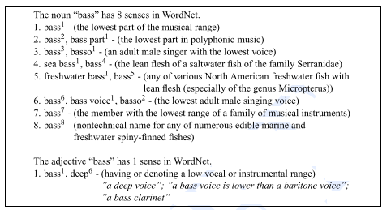
Lemma entry for noun & adjective: bass

Slide 33
Lemma entry for noun & adjective: bass
There are
8 senses for the noun
1 sense for the adjective
each of which has a gloss (a dictionary-style deﬁnition)
a list of synonyms for the sense (called a synset)
and
sometimes also usage examples (shown for the adjective sense).
Unlike dictionaries, WordNet doesn’t represent pronunciation

Slide 34
Synset
The set of near-synonyms for a WordNet sense is called a synset (for synonym set)
Synsets are an important primitive in WordNet.
Synsets actually constitute the senses associated with WordNet entries
It is synsets, not wordforms, lemmas or individual senses, that participate in most of the lexical sense relations in WordNet.

Slide 35
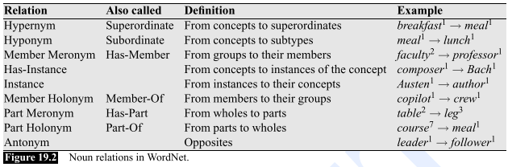
Synset
Each synset is related to its immediately more general and more speciﬁc synsets via direct hypernym and hyponym relations.

Slide 36
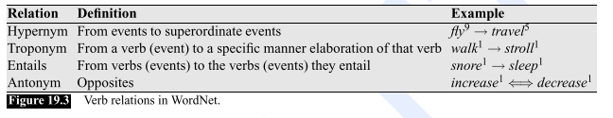
Synset
These relations can be followed to produce longer chains of more general or more speciﬁc synsets.

Slide 37
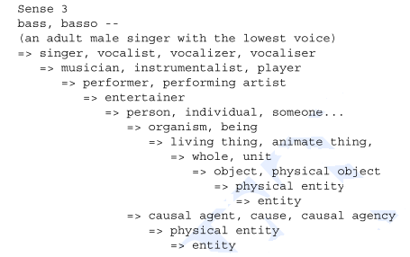
Hypernym chains for bass3

Slide 38
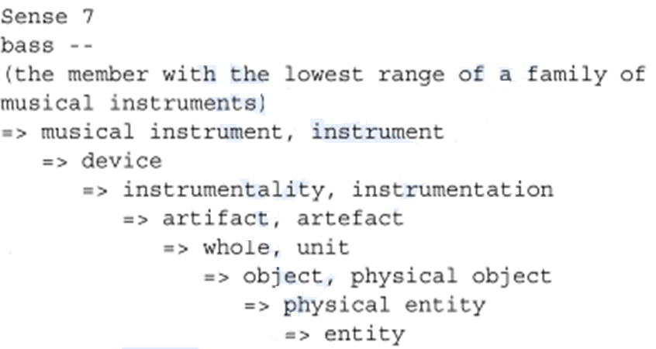
Hypernym chains for bass7

Slide 39
Word Sense Disambiguation

Slide 40
Word Sense Disambiguation (WSD)
WSD is the problem of determining which "sense" (meaning) of a word is activated by the use of the word in a particular context.
WSD is a natural classification problem
Given a word and its possible senses, as defined by a dictionary, classify an occurrence of the word in context into one or more of its sense classes.
Features of the context provide evidence for classification.

Slide 41
Approaches to WSD
Classified according to the source of knowledge used in word disambiguation.
Dictionary-based or Knowledge-based Methods
rely on dictionaries, treasures and lexical knowledge base
They do not use corpora evidences
E.g. Lesk method
Lesk algorithm is based is “measure overlap between sense definitions for all words in context”.

Slide 42
Approaches to WSD
2. Supervised Methods
ML methods make use of sense-annotated corpora to train.
These methods assume that context can provide enough evidence to disambiguate the sense.
Context is represented as a set of “features” of words.
These methods rely on a substantial amount of manually sense-tagged corpora

Slide 43
Approaches to WSD
3. Semi- supervised Methods
Due to the lack of training corpus, semi-supervised learning methods are popular.
Methods use both labelled as well as unlabeled data.

Slide 44
Approaches to WSD
4. Unsupervised Methods
The senses can be induced from text by clustering word occurrences by using some measure of similarity of the context.
This task is called word sense induction or discrimination.
They have potential to overcome knowledge acquisition bottleneck due to non-dependency on manual efforts.

Slide 45
Lec 25

Slide 46
Dictionary Based Disambiguation
Semantic roles express some of the semantics of an argument in its relation to the predicate.
E.g. book(argument) that flight(predicate)
A selectional restriction is a kind of semantic type constraint that a verb imposes on the kind of concepts that are allowed to ﬁll its argument roles.
Two fundamental approaches to handle this problem :
Integrated Rule-to-rule Approach
Stand-alone Approach

Slide 47
Integrated Rule-to-rule Approach
In this method, the selection of the correct word sense occurs during semantic analysis as a side effect of elimination of ill-formed semantic representations.
One method is Selectional Restriction-Based Disambiguation

Slide 48
Stand-alone Approach
In this approach, sense disambiguation is performed independent of compositional semantic analysis.

Slide 49
Selectional Restriction-Based Disambiguation
In this approach, the selectional restrictions and type hierarchies are the primary knowledge-sources used for performing disambiguation.
These sources are used to rule out inappropriate senses and thereby reduce the amount of ambiguity present during semantic analysis.

Slide 50
Selectional Restriction-Based Disambiguation
Selectional restrictions are used to block the formation of component meaning representations that contain selectional restriction violations.
By blocking such ill-formed components, the semantic analyzer will find itself dealing with fewer ambiguous meaning representation.

Slide 51
Example:
Which airline serve NewYork?
Which airlines serve breakfast?
Disambiguation : by the selectional restrictions imposed by ‘NewYork’ and ‘breakfast’ on PATIENT roles, along with the semantic type information associated with it.
The predicate selects the correct sense of an ambiguous argument by eliminating the senses that fails to match one of its selectional restrictions.

Slide 52
Selectional Restriction-Based Disambiguation
There are also cases where both the predicate and the argument have multiple senses.
E.g. I am looking for restaurants that serve vegetarian dishes.
Determining the correct sense is done by mutually selecting the correct senses.

Slide 53
Selectional Restriction-Based Disambiguation
This approach requires two additions to the knowledge structures:
access to the hierarchical type information about arguments
semantic selectional restriction information about the arguments to predicates.
The type information is available in the form of hypernym information about the heads of the meaning structures being used as arguments to predicates.

Slide 54
Selectional Restriction-Based Disambiguation
Selectional restriction information about argument roles can be encoded by associating the appropriate WordNet synsets with the arguments to each predicate-bearing lexical item

Slide 55
Limitations of Selectional Restrictions
The available selectional restrictions are too general to uniquely select a correct sense.
E.g. What kind of dishes do you recommend?
How to deal with obvious violations of selectional restrictions?
E.g. But it fell apart in 1931, because people realized that you cannot eat gold for lunch

Slide 56
Limitations of Selectional Restrictions
Another challenge is the usage of metaphoric and metonymic uses
E.g. He is a tiger in the class
E.g. Tiger called his students to the meeting room

Slide 57
How to overcome these limitations?
Adopt selectional restrictions as preferences, rather than rigid requirements.
Go for selectional association, which treats it as a probabilistic measure of the strength of association between a predicate and a class dominating the argument to the predicate.

Slide 58
Robust Word Sense Disambiguation
The selectional restriction approach has too many requirements such as
complete selectional restriction information for all predicate roles
complete type information for the senses.
The stand alone approach involves using minimal information from other processes.

Slide 59
Machine Learning Approaches
In these approaches, a classifier is used to assign yet unseen examples to a fixed number of senses.
The efficiency of the WSD classifier depends on
nature of the training material
how much material is needed
the degree of human intervention
the kind of linguistic knowledge used and
the output produced.

Slide 60
The Inputs: Feature Vectors
The initial input consists of
the word to be disambiguated (target word) along with a portion of text in which it is embedded(context).
This initial input is processed in the following ways:
The initial input is POS tagged
The context is replaced with larger or smaller segments
Some amount of morphological processing like stemming is performed on contexts
Some form of dependency parsing is performed to ascertain grammatical roles and relations

Slide 61
The Inputs: Feature Vectors
After initial processing, the input is brought down to a fixed set of features that capture relevant information.
A simple feature vector consists of numeric or nominal values which can be easily encoded.
The linguistic features can be divided into two classes: collocational features and co-occurrence features.

Slide 62
Collocational Features
They are quantifiable position-specific relationship between lexical items
It encode information about the lexical inhabitants of specific positions located to the left and right of the target word
Typical features include the word, root form of the word and POS of the word.

Slide 63
Collocational Features
E.g. An electric guitar and bass player stand off to one side which is not really part of the scene
A feature vector consisting of two words to the right and left of the target word, along with their respective POS is:
guitar(NN1) and (CJC) player(NN1) stand(VVB)

Slide 64
Co-occurrence Feature
Co-occurrence features are data about neighboring words ignoring their exact positions
Here the words themselves serve as features (play/music)
The value of the feature is the number of times the word occurs in a region surrounding the target word
E.g. (bass: no of times play/music is occuring surrounding the word bass)

Slide 65
Co-occurrence Feature
Thus features are small number of frequently used content words.
This feature is effective in capturing general topic of discourse in which target word has occurred.
E.g. co-occurrence vector for the word bass would have the following words as features:
fishing,big, sound,player, fly,rod, pound, double, playing, guitar

Slide 66
Co-occurrence Feature
Using these words as features with a window size of 10 would be represented by the following vector:
[0,0,0,1,0,0,0,0,1,0]

Slide 67
Supervised Learning Approaches
A learning system is presented with a training set consisting of feature-encoded inputs along with their appropriate label or category.
The output of the system is a classifier system capable of assigning labels to new feature-encoded inputs.
The different classifiers that can be used are:
Bayesian Classifier
Decision Trees
Neural Networks
KNN

Slide 68
Bootstrapping Approaches
The bootstrapping approach eliminates the need for a large training set by relying on a relatively small number of instances of each sense.
These labelled instances used as seeds to train an initial classifier.
This initial classifier is then used to extract a larger training set from the remaining untagged corpus.
Repeating this process, results in a series of classifier.

Slide 69
Bootstrapping Approach
The initial seeds can be generated in a number of ways.
One way to generate a seed set is by simply handlabeling a small set of examples.
This approach has the following advantages
There is a certainty that seed instance are correct
The analyst can make some prototypical of each sense
It is reasonably easy to carry out.

Slide 70
Unsupervised Methods
Feature vector representations of unlabelled instances are taken as input and are then grouped into clusters according to a similarity metric
These clusters are then labelled by hand.
Unseen feature encoded instance is classified by assigning word sense from the cluster with closest similarity index.
A frequently used technique : Agglomerative Clustering

Slide 71
Drawbacks of Unsupervised Methods
The correct senses of the instances used in the training data may not be known
The clusters are almost certainly heterogeneous with respect to the senses of the training instances contained within them.
The number of clusters is almost always different from the number of senses of the target word being disambiguated.

Slide 72
Dictionary Based Methods
All ML approaches require a considerable amount of work to create a classifier for each ambiguous entry in the lexicon
Scaling up these approaches would be a large undertaking
To perform large-scale disambiguation, machine readable dictionaries are needed
E.g. Lesk Algorithm

Slide 73
Lesk Algorithm
In this approach, all the senses definitions of the word to be disambiguated are retrieved from the dictionary
Each of these senses is then compared to the dictionary definitions of all the remaining words in the context
The sense with the highest overlap with these context words is chosen as the correct sense.

Slide 74
Lesk Algorithm
E.g. Finding the appropriate sense of cone in the phrase pine cone given the following definitions:
Pine:
Kind of evergreen tree
Waste away through sorrow or illness
Cone:
Solid body which narrows to a point
Something of this shape whether solid or hollow
Fruit of certain evergreen trees

Slide 75
Lesk Algorithm
The lesk algorithm will select cone(c) as the correct sense since two of the words in its entry: evergreen and tree, overlaps with the words in the entry for pine.
Neither of the other entries have any overlap with words in the definition of pine.
Disadvantage of Lesk Algorithm : The dictionary entries for the target words are relatively short and may not provide sufficient material to create adequate classifiers.

Slide 76
How to overcome this disadvantage?
Remedy: Expand the list of words used in the classifier to include words related to but not contained in their individual sense definitions.
This can be accomplished by including words whose definitions make use of the target word.
E.g. the word deposit does not occur in the definition of bank in the American Heritage Dictionary. However, banks do occur in the definition of deposit. Therefore the classifier for bank must include deposit as a relevant feature.

Slide 77
How to overcome this disadvantage?
Subject Codes : The word deposit can be related to financial deposit or mud deposit. So there is still ambiguity with respect to its usage. This problem can be solved with the help of Subject Codes.
Many dictionaries include tags known as subject codes in their entries that correspond roughly to broad conceptual categories.

Slide 78
How to overcome this disadvantage?
E.g.the entry for bank in Longman’s dictionary includes subject code EC(Economics) for the financial sense of the bank.
Given such subject codes,the expanded terms in subject code can be related to this sense of bank

Slide 79
End of Module 4

